Slide 1
Amazon Fresh
E-commerce & Retail Analytics with SQL
Sangeetha Gunasekaran

Slide 2
Table of Contents
1
Preparation
6
Clauses & Aggregations
2
Key Identification
7
Complex Aggregations & joins
3
Table relationship summary
8
Normalization
4
ER Diagram
9
Subqueries & Nested Queries
5
DDL , DML, Constraints &
Operators
10
Real-world Analysis

Slide 3
Preparation for Data modelling
Downloading data as CSV files
Creating new database
Tables creation with headers
Importing data into Tables
Identifying Relationships b/w tables
Finding Primary & Foreign keys
Making connection between tables through queries

Slide 4
Keys Identification
Table Name | Primary Key(s) | Foreign Key(s) | References
Customers | customer_id | — | —
Orders | order_id | customer_id | Customers(customer_id)
Order_Details | order_id, product_id (Composite PK) | order_id, product_id | Orders(order_id), Products(product_id)
Products | product_id | – | —
Reviews | review_id | customer_id, product_id | Customers(customer_id), Products(product_id)
Suppliers | — | — | —

Slide 5
Table Relationships Summary
From Table | To Table | Relationship Type | Description
Customers | Orders | One-to-Many | One customer can place multiple orders
Orders | Order_Details | One-to-Many | One order can have multiple order items
Products | Order_Details | One-to-Many | One product can appear in multiple order items
Orders | Products | Many-to-Many | Orders and products are linked via Order_Details
Customers | Reviews | One-to-Many | One customer can write multiple reviews
Products | Reviews | One-to-Many | One product can receive multiple reviews
Suppliers | Stand alone | NIL | NIL

Slide 6
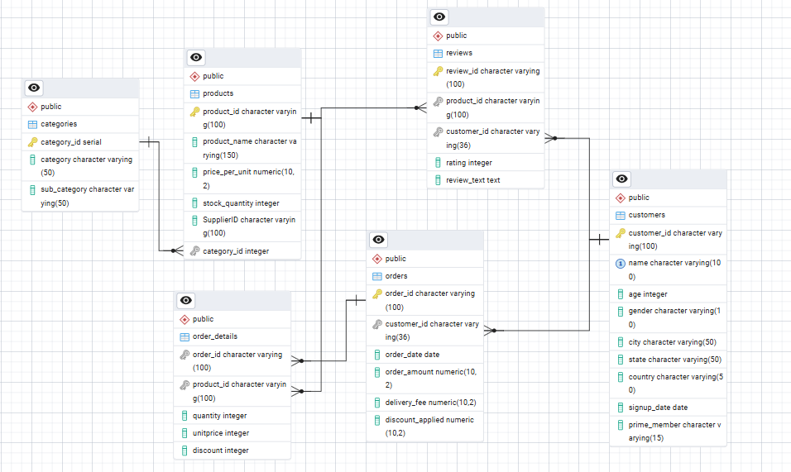
Helps understand the overall data structure for analyzing customers, orders, products, and reviews.
visual blueprint of the database schema, showing how data is connected across tables.
ER Diagram

Slide 7
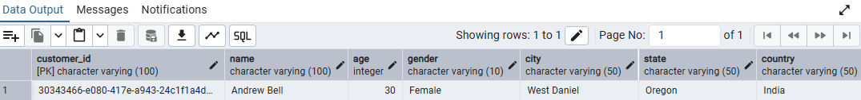
Task 3: Queries
Retrieve all customers from a specific city.
SELECT * from customers where city ='West Daniel';
Fetch all products under the "Fruits" category.
SELECT * from products where category='Fruits';

Slide 8
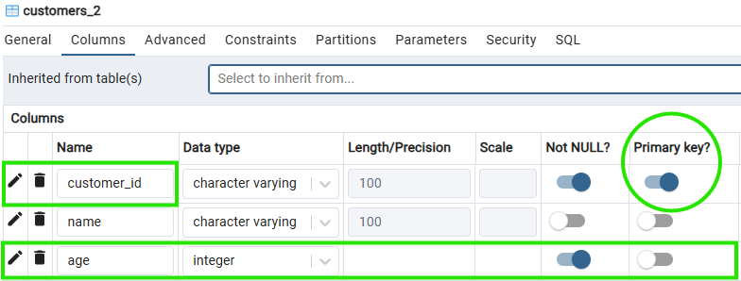
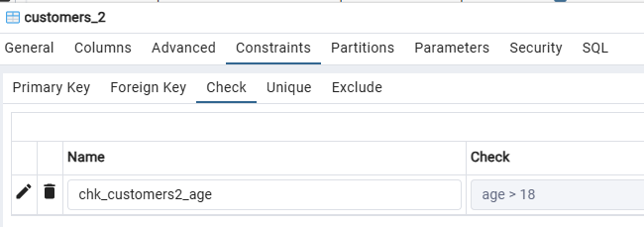
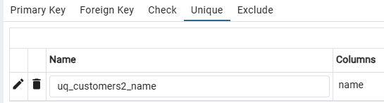
Task 4: DDL statements with Constraints:
CustomerID as the primary key.
Age cannot be null & Age > 18.
Add a unique constraint for Name.

Slide 9
Data Manipulation Language (DML)
Task 5: Insert 3 new rows into the Products table using INSERT statements.
Syntax used: INSERT INTO table_name (column1, column2, column3, ...)
VALUES
(value1, value2, value3, ...),
(value1, value2, value3, ...);
Task 6: Update the stock quantity of a product where ProductID matches a specific ID
UPDATE products
SET stock_quantity= 2000 where product_id='123';
Task 7: Delete a supplier from the Suppliers table where their city matches a specific value
DELETE FROM suppliers WHERE city = 'West Linda';

Slide 10
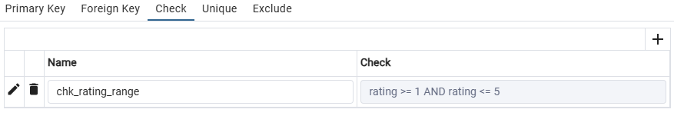
Task 8: SQL Constraints & Operators
Add CHECK constraint to ensure that ratings in the Reviews table are between 1 and 5.
Add a DEFAULT constraint for the PrimeMember column in the Customers table (default value: "No")

Slide 11
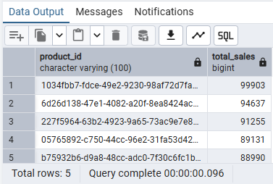
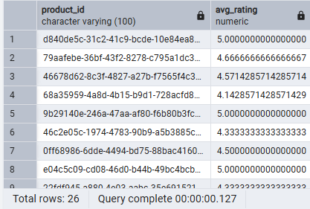
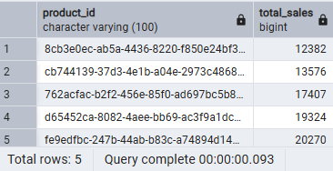
Clauses & Aggregations
TASK 9: TOP 5 HIGH SALES VALUE PRODUCTS
Task 9: Products with average ratings greater than 4
LEAST SALES VALUE PRODUCTS

Slide 12
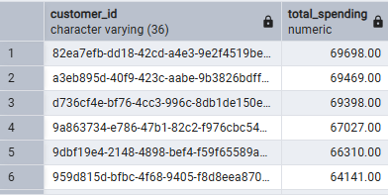
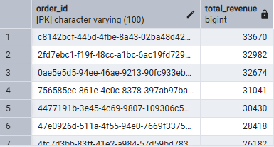
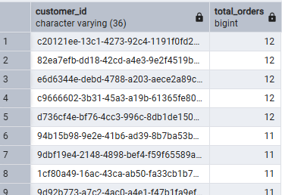
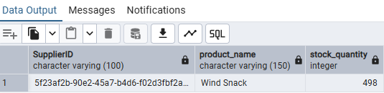
Task 10: Each customer's total spending from high to low
Task 11: Aggregations and Joins
Task 11: Total Revenue per Order
Task 11: customers who placed the most orders
Task 11: Supplier with the most products in stock

Slide 13
Step 1: Create new table _Categories - columns: categories & subcategories, Category ID - serial datatype
Step 2: Insert unique Cat & Sub-cat values from products table using distinct
Step 3: Add column Category ID to products table and update values from Categories table
Step 4: Make connection between tables with Category ID as foreign key
Step 5: Delete old categories & subcategories column from Products
Task 12: Normalization
To Separate product categories and subcategories into a new table & Create foreign keys to maintain relationships.

Slide 14
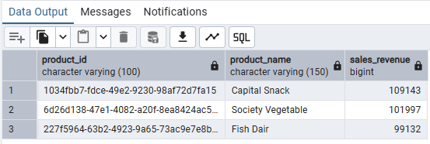
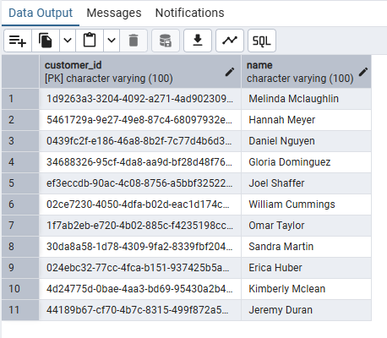
Task 13: Top 3 products based on sales revenue
SUB QUERIES
Task 13: Customers who haven’t placed any orders yet

Slide 15
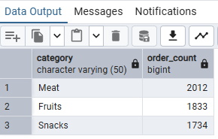
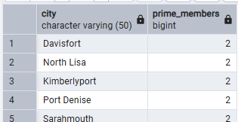
Task 14: Provide actionable insights:
Cities having highest concentration of Prime members
Top 3 most frequently ordered categories
Strategic action plans:
Launch Prime-only discounts on Meat, Fruits, and Snacks in high-Prime cities.
Implement faster delivery or same-day delivery for these categories in those locations.
Promote personalized recommendations for these categories to Prime users.

